Slide 1

Gramin Kissan System
Presented By
Exam Roll No: 21MCRMS970047
Guided By: Mrs. Dipti Prasad
MCA - IV Semester
(Session : 2021-2023)
MARWARI COLLEGE, RANCHI

Slide 2
Project Objectives: The primary objective of this agricultural website project is to create an all-encompassing online platform that bridges the existing gaps in the agricultural sector. The platform aims to:
Provide a user-friendly interface for farmers to access real-time weather updates, pest and disease management recommendations, and best practices for crop cultivation.
Facilitate knowledge exchange by offering discussion forums, webinars, and articles contributed by agricultural experts and experienced farmers.
Establish a digital marketplace that connects farmers directly with buyers, thereby eliminating intermediaries and ensuring fair prices for agricultural products.
Offer a repository of modern agricultural technologies, tutorials, and resources, empowering farmers to adopt sustainable and efficient farming practices.
Enable data collection and analysis to identify trends, challenges, and opportunities in the agricultural sector, thereby guiding policymakers and researchers in making informed decisions.

Slide 3
Understanding:- Identified problems and assessing their remedies is one of the attributes of good system analyst. A system analyst should have the grasp of company goals and objective.

Slide 4
Software Used
Frontend : HTML, CSS
Backend: MySql
Business Logic: Php, Java Script
Server : XAMPP

Slide 5
PHP: PHP is a server-side scripting language designed specifically for the web. Within an HTML page, we can embed PHP code that will be executed each time the page is visited. Our PHP code is interpreted at the web server and generates HTML or other output that the visitor will see. HTML: The hypertext markup language (HTML) is a simple markup language. Used to create a hypertext documents that are portable from one platform to another HTML documents are SGML (Standard generalized mark up language) documents with generic semantics that are appropriate for representing information from a wide range of applications. CSS is the acronym of “Cascading Style Sheets”. CSS is used to define styles for your web pages, including the design, layout and variations in display for different devices and screen sizes. JavaScript :JavaScript is a scripting language that enables you to create dynamically updating content, control multimedia, animate images, and pretty much everything else. MySql: It may be anything from a simple shopping list to a picture gallery or the vast amounts of information in a corporate network. To add, access, and process data stored in a computer database, you need a database management system such as MySQL Server. XAMPP : XAMPP is a free and open-source cross-platform web server solution stack package developed by Apache Friends, consisting mainly of the Apache HTTP Server, MariaDB database, and interpreters for scripts written in the PHP and Perl programming languages.

Slide 6
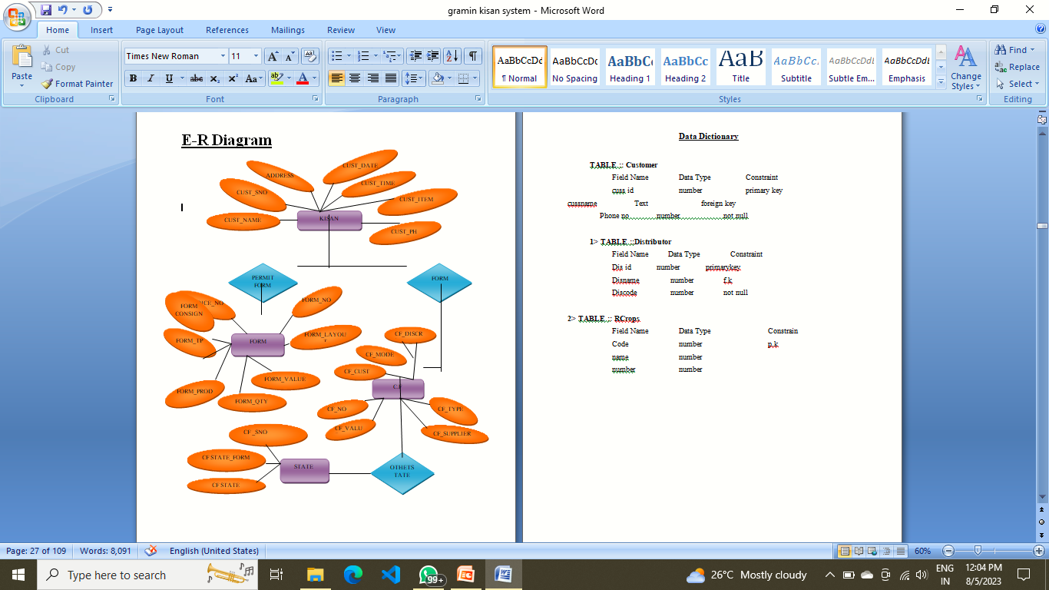
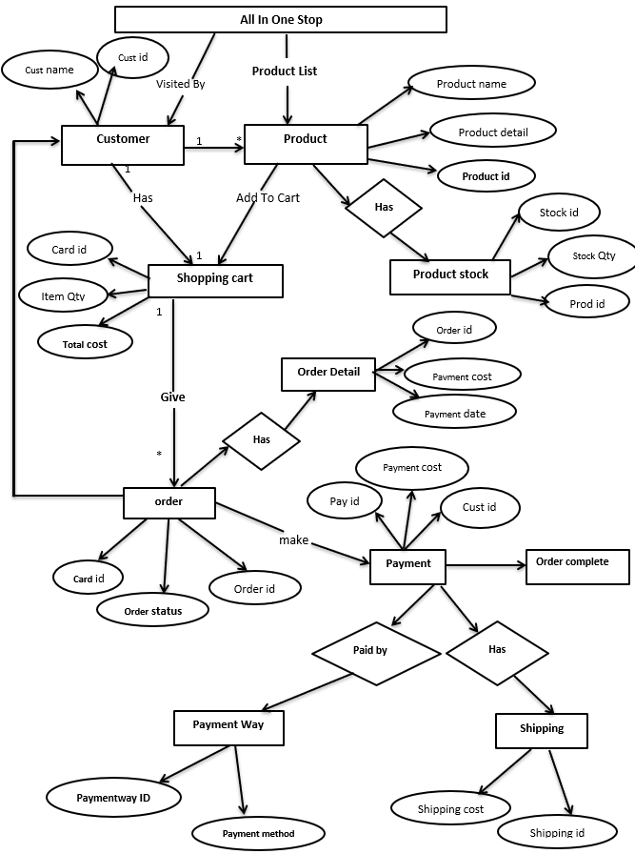
ER-Diagram

Slide 7
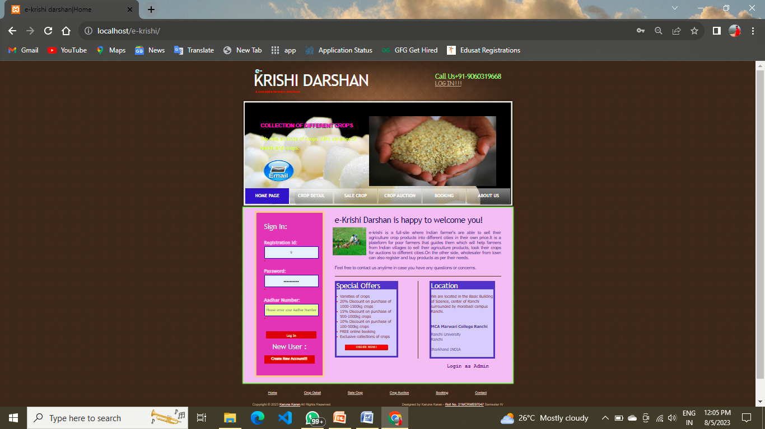

Screenshot

Slide 8


